Slide 1

Codebasics Resume Challenge 11
Election Analysis – 2014 & 2019

Slide 2
Project Objective
“AtliQ Media” is a private media company and they wanted to telecast a show on Lok Sabha elections 2024 in India. Unlike other channels they do not want to have a debate on who is going to win this election, they rather wanted to present insights from 2014 and 2019 elections without any bias and discuss less explored themes like voter turnout percentage in India.

Slide 3
Insights Request
Analyzing voter turnout % in each state and constituency.
Analyzing vote share of two National Parties – BJP and INC in state as well as National level.
Checking whether voter turnout % is affected by any factor or not.

Slide 4




Data Preparation & Transformation
Addition of Missing states – Odisha and Chhattisgarh in 2014 election dataset.
+
=
Original 2014 dataset
Missing 2014 dataset
Updated 2014 dataset
Creating a final table containing updated 2014 election and 2019 election dataset

Slide 5
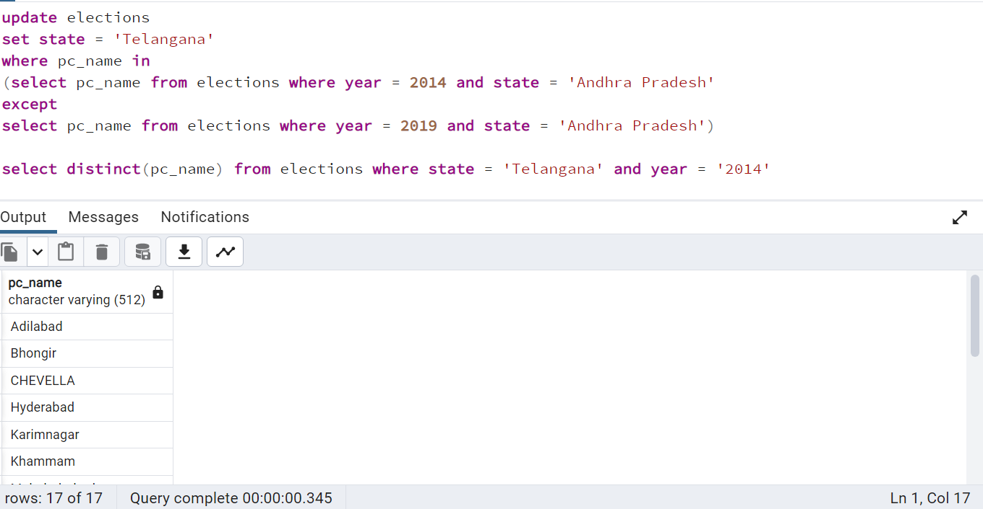
Data Cleaning
Renaming of Constituency - Bikaner SC , Jaynagar, Bardhaman Durgapur , CHEVELLA, NOTA, Dadra and Nagar Haveli
Removal of extra spaces(trimming) all the Columns
Update of 2014 Andhra Pradesh Constituencies to Telangana

Slide 6
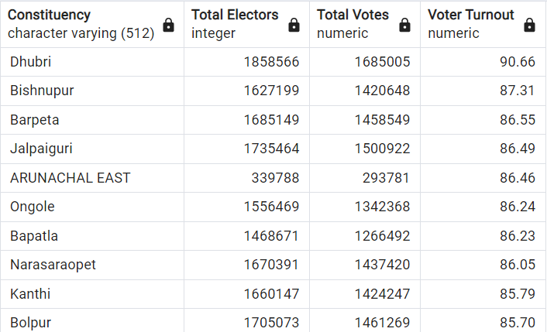
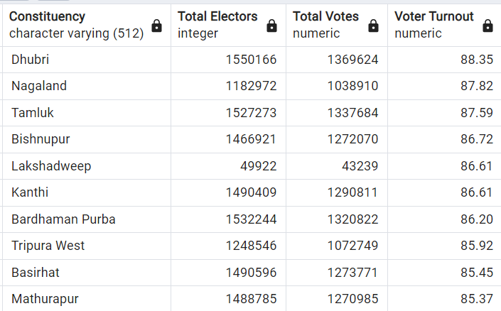
Top 10 Constituencies in terms of Voter Turnout %
2019
2014

Slide 7
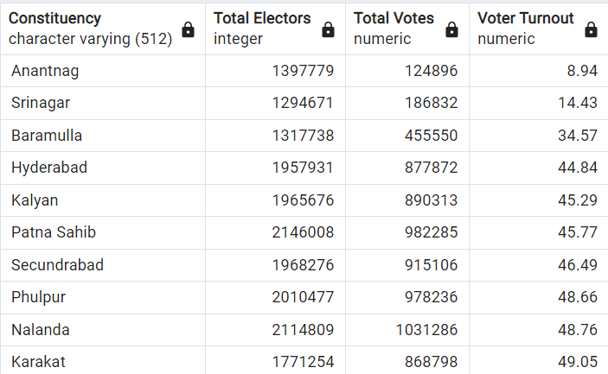
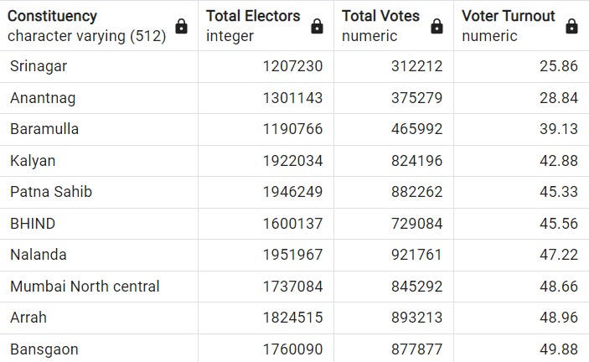
Bottom 10 Constituencies in terms of Voter Turnout %
2019
2014

Slide 8
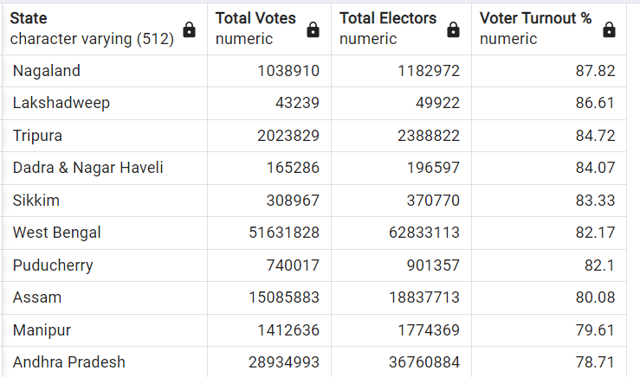
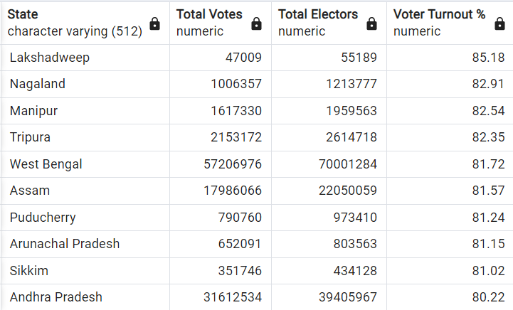
Top 10 State/Union Territory in terms of Voter Turnout %
2014
2019

Slide 9
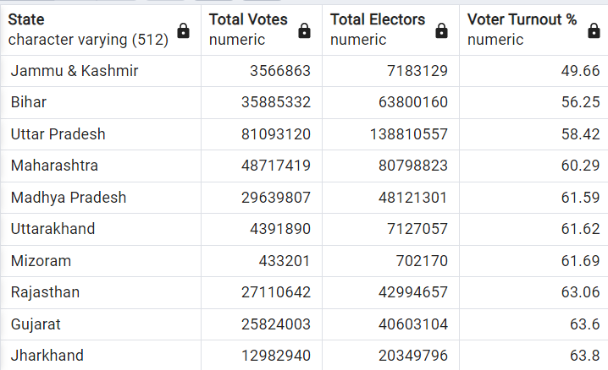
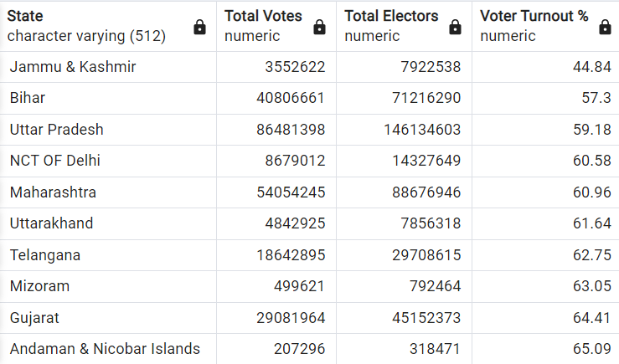
Bottom 10 State/Union Territory in terms of Voter Turnout %
2014
2019

Slide 10
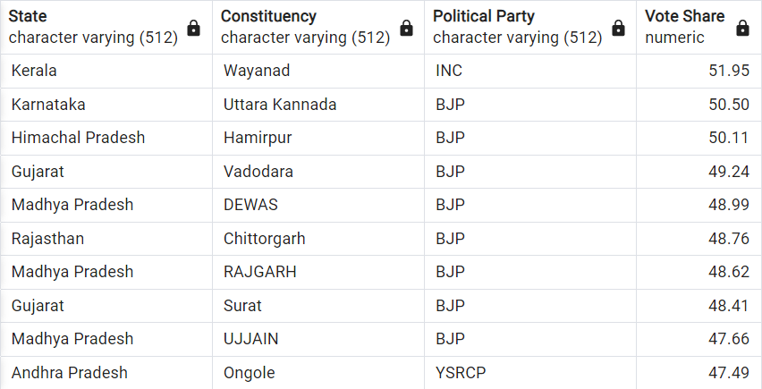
Top 10 Constituency Electing Same Party

Slide 11
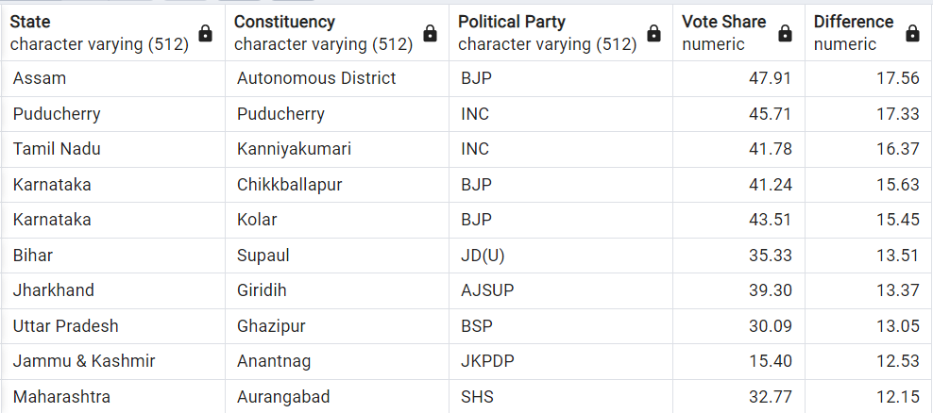
Top 10 Constituency Electing Different Party Constituency are ranked on basis of Difference in vote share of 2019 and 2014

Slide 12
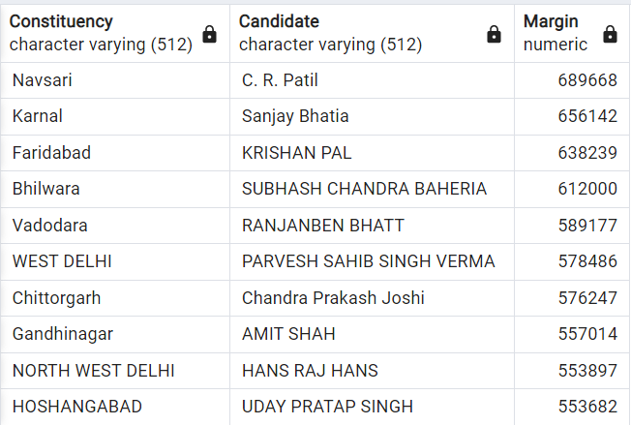
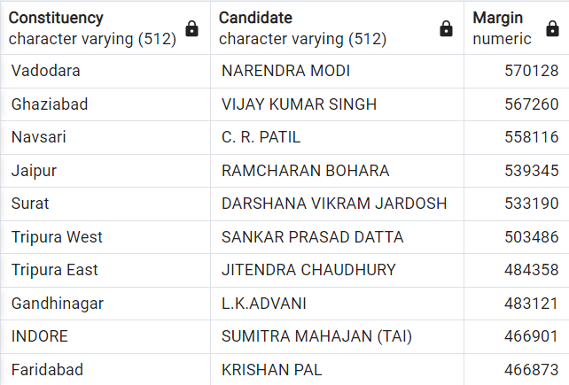
Top 10 Candidates based on Margin
2019
2014

Slide 13
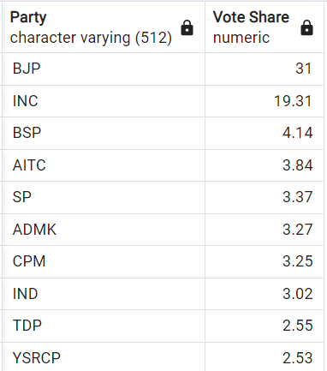
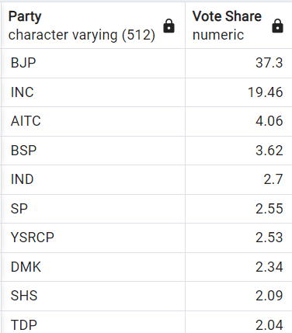
Top 10 Parties based on Vote Share at National Level
2014
2019

Slide 14
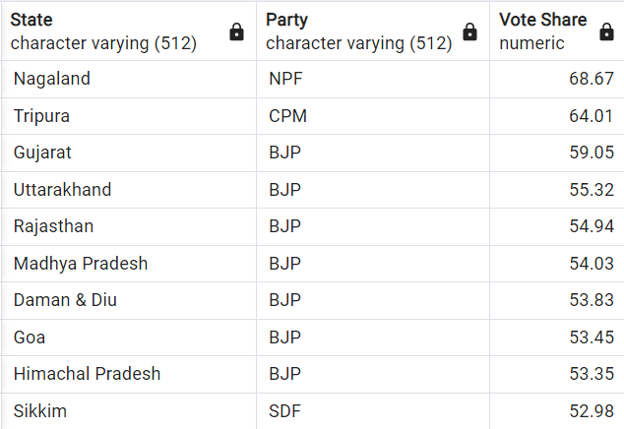
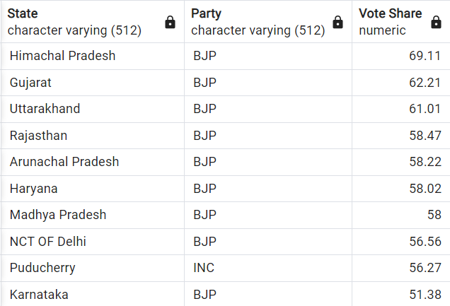
Top 10 Parties based on Vote Share at State Level
2014
2019

Slide 15
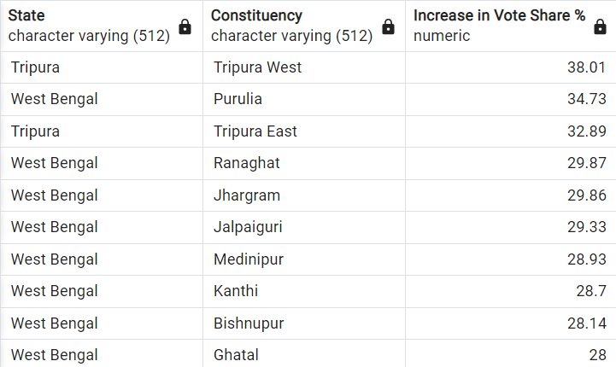
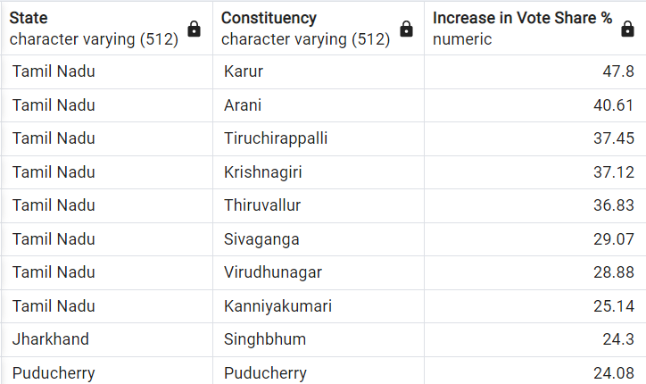
Top 10 Constituencies where vote share has increased
BJP
INC

Slide 16
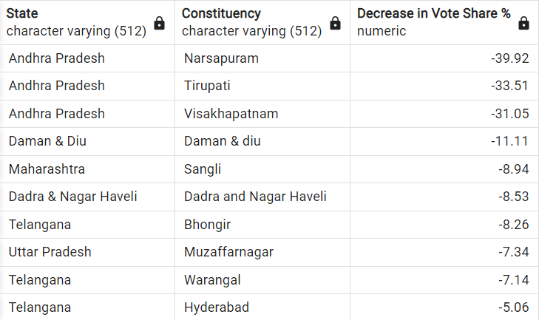
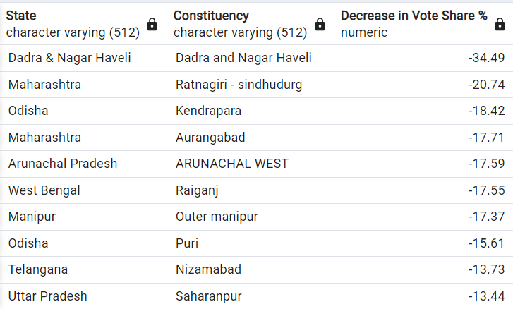
Top 10 Constituencies where vote share has decreased
BJP
INC

Slide 17
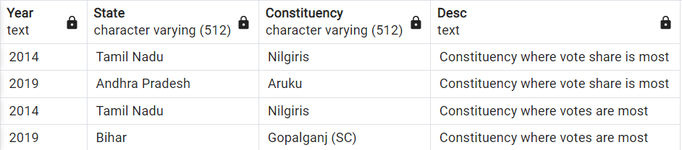
Constituency where NOTA has been voted most

Slide 18
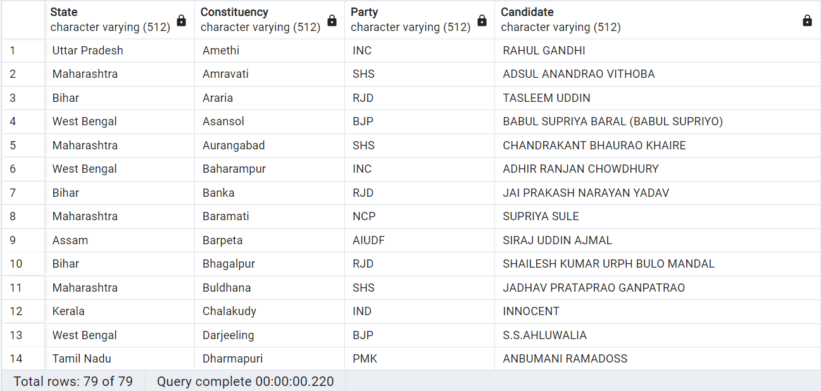
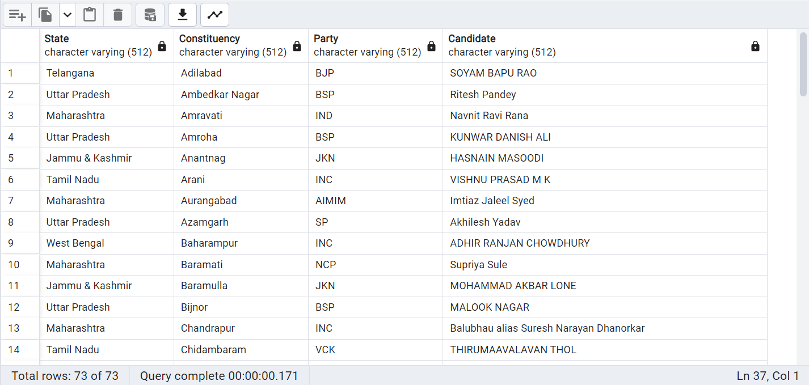
Constituency which have elected candidate, but their party’s vote share is less than 10 % at state level
2014
2019

Slide 19
Factors affecting Voter Turnout % There is no specific factor which can directly affect voter turnout %

Slide 20
Factors affecting Voter Turnout % There is no specific factor which can directly affect voter turnout %

Slide 21
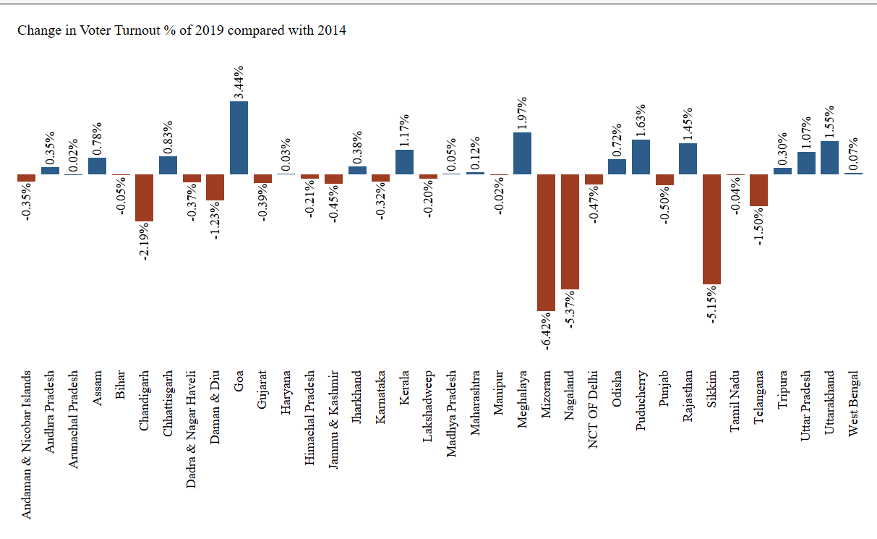
2014 vs 2019 Analysis

Slide 22
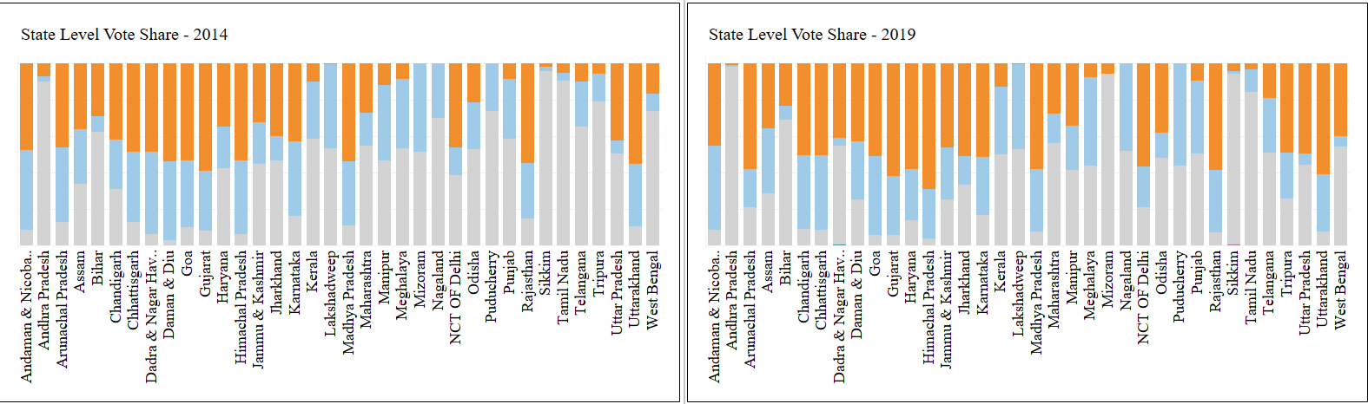
State Level Vote Share

Slide 23
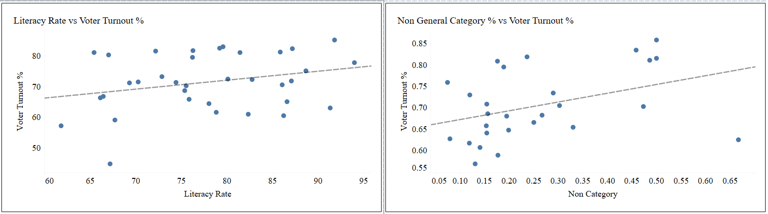
Relations with Voter Turnout

Slide 24
Recommendations to improve voter turnout
Voter Awareness Campaigns – Use media , social media and campaigns to inform people about election process, their leaders and importance of vote.
Ease of Access – Implement online voter registration and ensure polling booths are conveniently located. Along with polling booth information, candidate’s information(name and party symbol) should be mentioned in voter slip.
Technology – With the help of technology, voters can vote for their constituency from nearby located polling booth to avoid any travels, thus a day is enough for conducting election.
Election Day Policy – Along with holiday, paid time off should be given to all working people.

Slide 25

Thank You!

